Slide 1

Child Protection and Safeguarding Assembly
Thursday 12th September

Slide 2
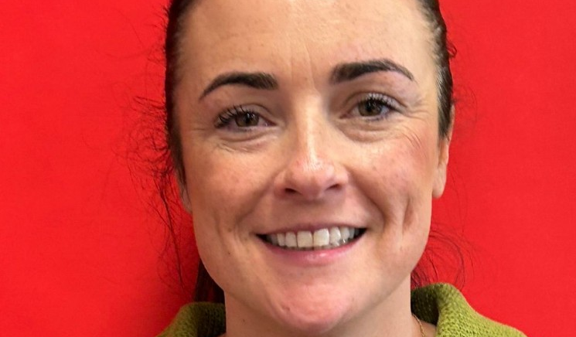
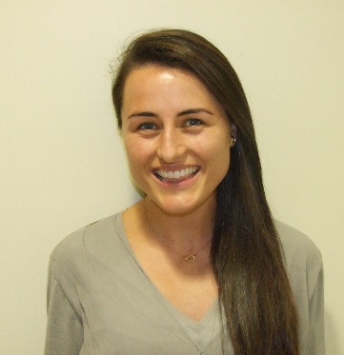
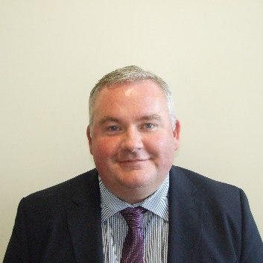
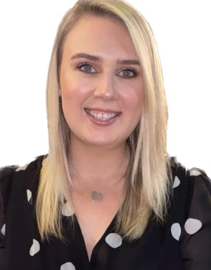
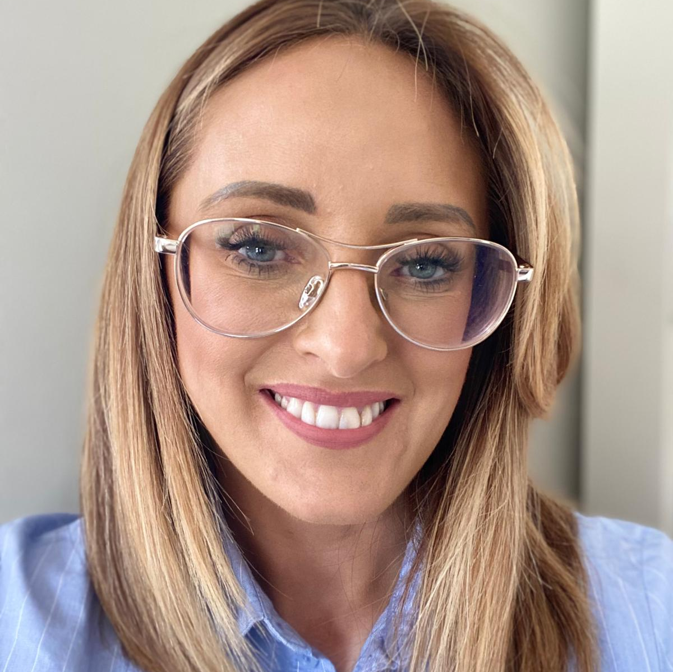
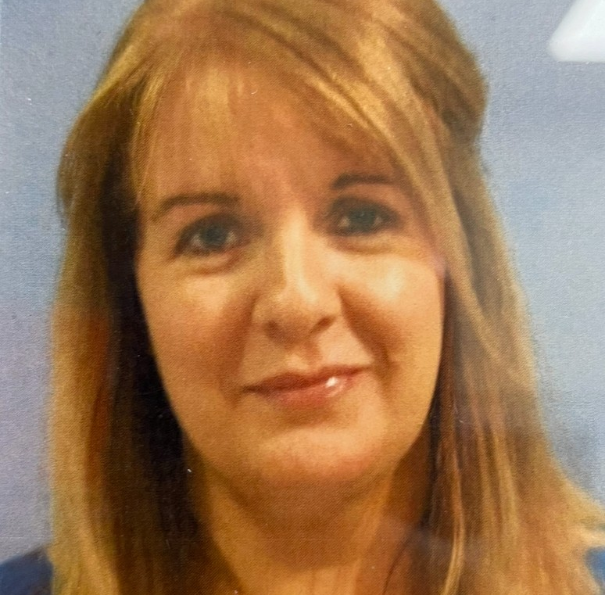
St. Mary’s Safeguarding Team

Slide 3
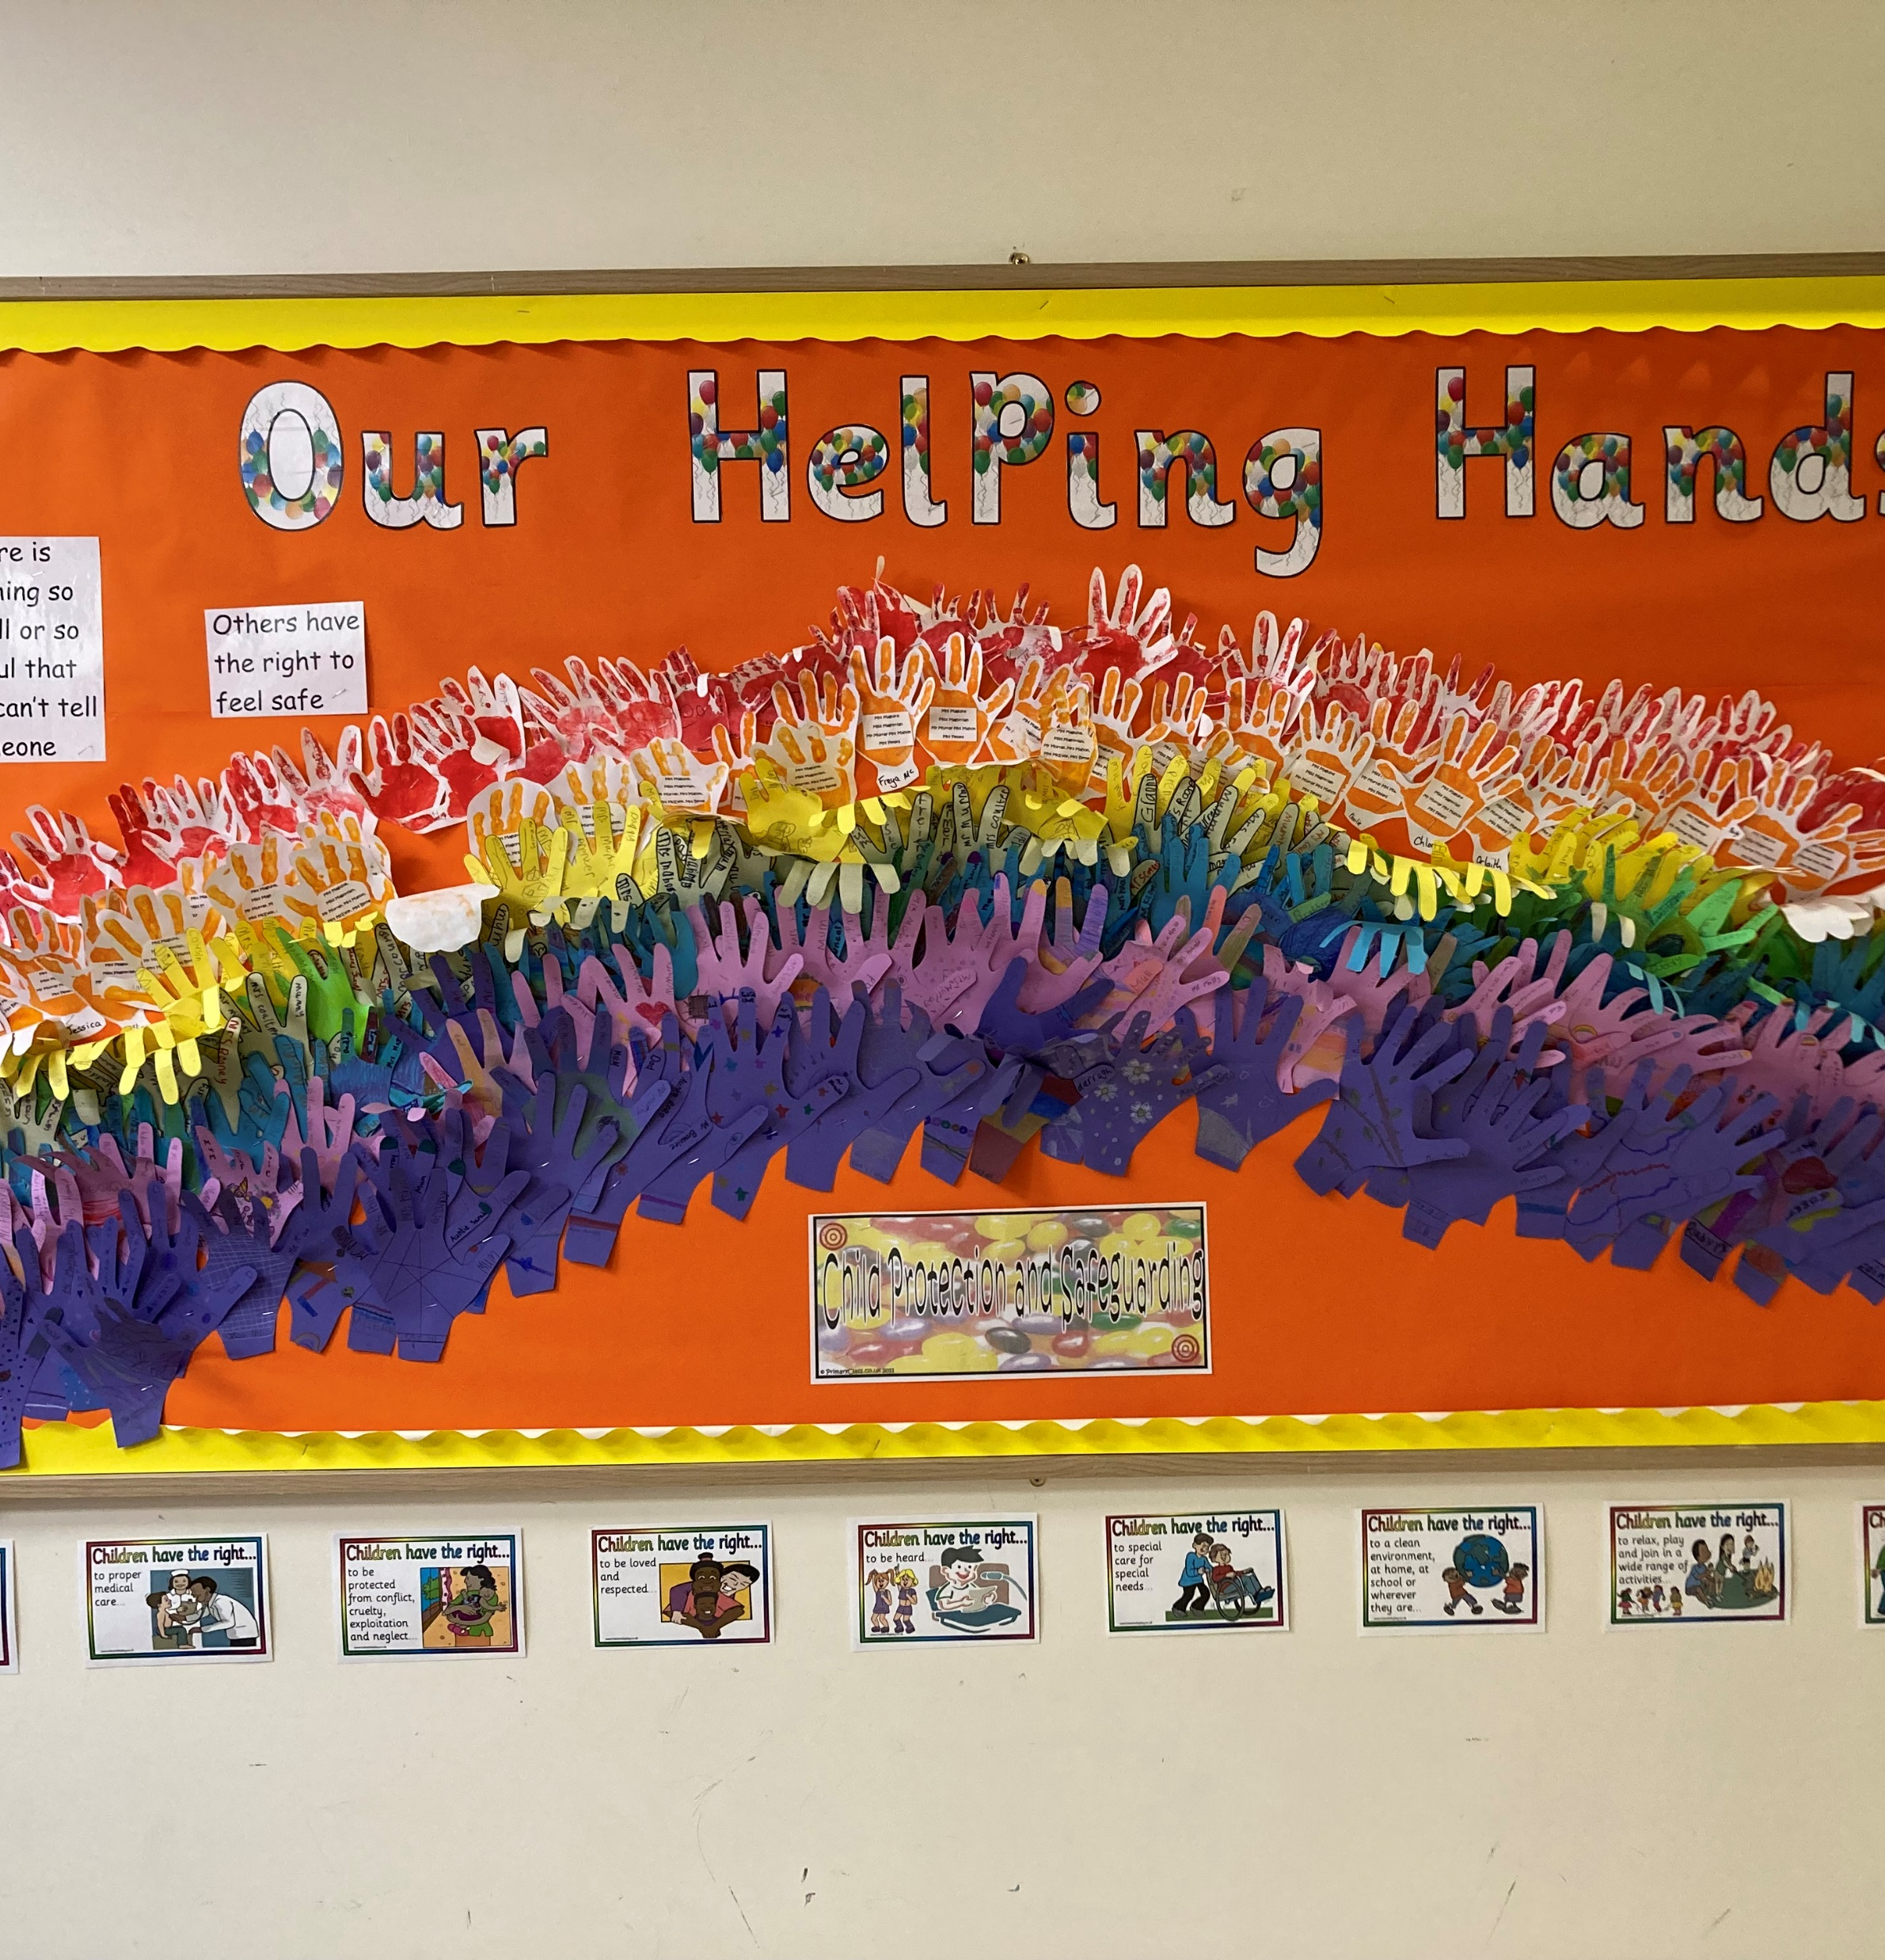
Trusted Adults
When you have a worry or concern, you need to speak to a trusted adult. In school, your trusted adult may be a member of the Safeguarding Team but it can be any adult in school who you have a good relationship with.
If you are worried about something at home, always speak to your mummy, daddy or any other trusted adult.
Remember it helps us all to share our worries.
You can also share your worries in our Worry Box
Nothing is too big or too small or so awful that you can’t tell someone.

Slide 4
Buddy not Bully!
Thankfully, we do not have a lot of bullying in our school but sometimes little boys and girls experience friendship difficulties. It is important that if this happens to you, you need to tell a member of staff how you are feeling, so we can help you.
Staff and children have worked very hard last year to think about bullying and how we can stop it happening in St. Mary’s.

Slide 5

Our School Pledge
We promise to be kind and treat others with care,
To show respect to everyone, everywhere.
We ‘ll stand up against bullying, and make it clear,
That in our school, there’s no room for it here.

Slide 6
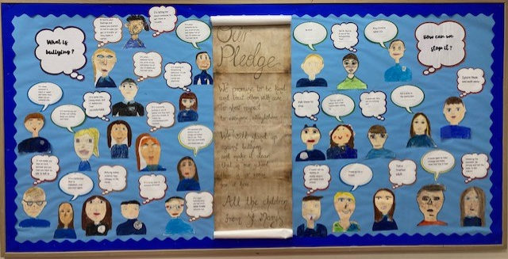

Slide 7

What is Bullying?
Being mean to someone every day
When someone hurts you, picks on you and makes fun of you and makes you feel sad inside
Pushing someone around and taking your stuff, damaging your belongings or hiding your things
Leaving you out at play
Calling someone names
Keeping on doing it over and over again
Physical, verbal and emotional bullying
Stealing or threatening behaviour
Talking behind your back
Cyber bullying when you say stuff online to make someone sad
Constantly picking on you in games and they don’t give you a break

Slide 8
T.R.I.P
T for targeted
R for repeated
I for intentional or to do it on purpose
P for physical or emotional harm

Slide 9

How can we stop bullying in our school?
Tell a trusted adult
Ignore them!
Tell Mr Murray or Mrs Rogan
Tell a member of the Safeguarding Team
Put a note in the Worry Box

